Slide 1
Project Luther
Kevin Mardakhayev

Slide 2






SMALL BUDGET LARGE BUDGET

Slide 3
 | Small Budget | Large Budget
Approximate Range of Budget | .5 – 20 | 75 - 300
Average Domestic Total Gross | 33 | 143
Average Budget | 10 | 122
Average Profit | 23 | 20
Values in Millions

Slide 4
ROI:
Domestic Total Gross – Budget
Budget

Slide 5
Opening Weekend d Domestic Total Gross

Slide 6
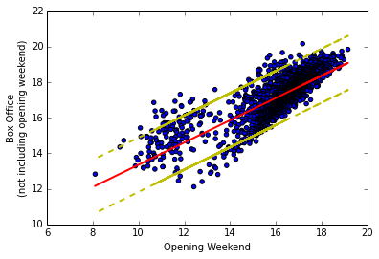
All Movies
Values in Log

Slide 7
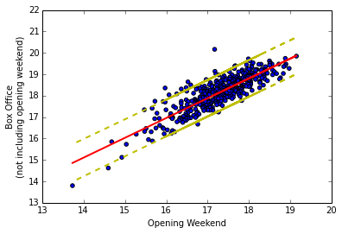
Big Budget Movies
Values in Log

Slide 8
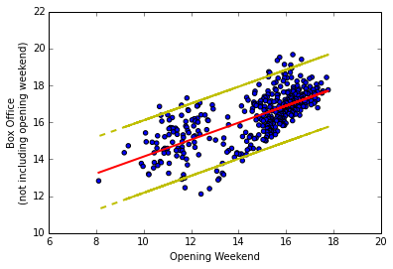
Small Budget Movies
Values in Log

Slide 9
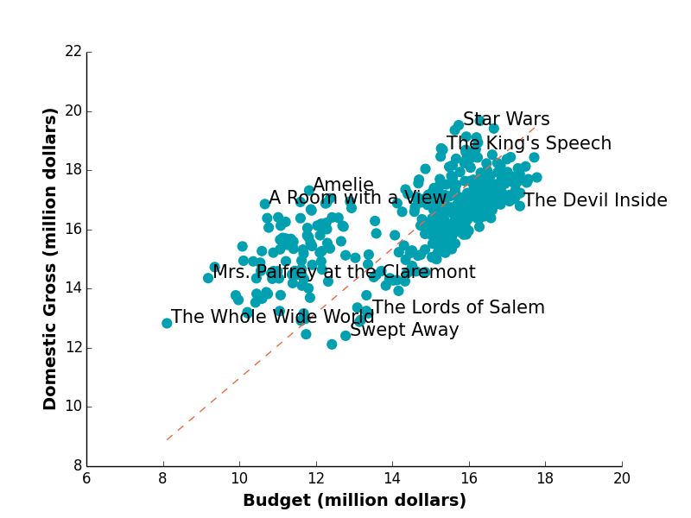
SMALL BUDGET
Values in Log

Slide 10
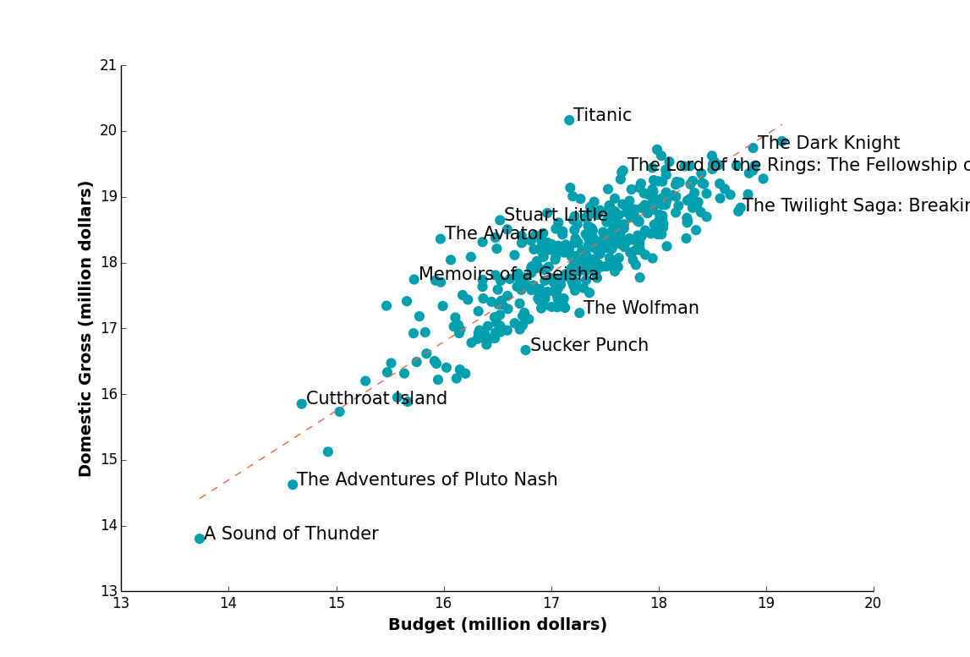
BIG BUDGET
Values in Log

Slide 11
Observations and Insights
Why would a studio want to produce a big budget film?
Similarly, what are the benefits and drawbacks of producing small budget film?
Notes:
Some observations
Why would a studio want a big budget film?
A lot more absolute revenue = a lot more people go to see a bug budget film, good for franchise and studio
Good for movie theaters
It is less risky even with more money involved, generally will hit budget, reviews matter less
Small budget films will generally have to have “good” reviews to generate ROI, and there is more variance = increased risk/reward.
Independent films are on the come back, focusing on specific audience yet becoming mainstream.

